Slide 1
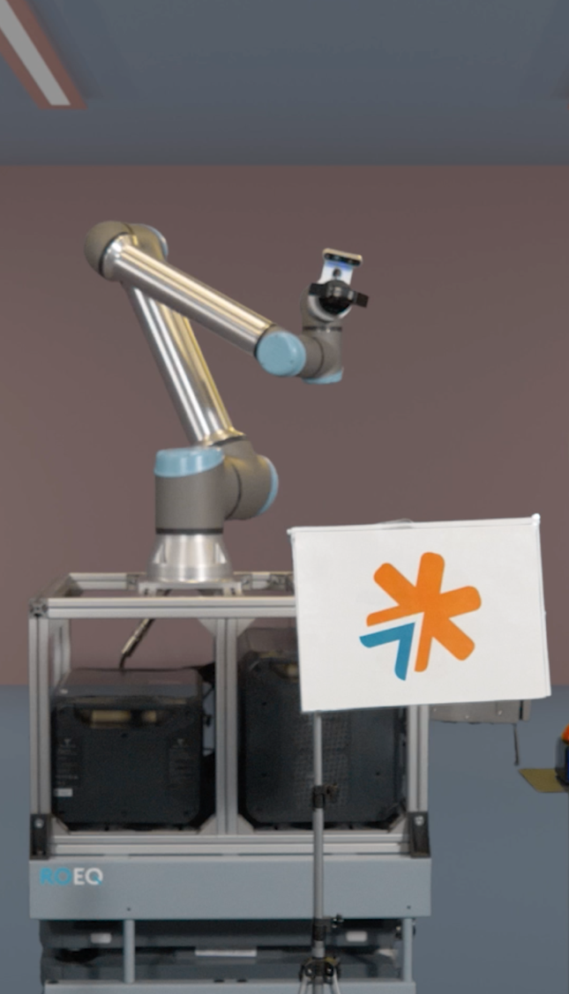

Moon Landing Activity:
Jobs in Aerospace
Teaching guide | ages 7+
v1.2 2026

Slide 2


Jobs in Aerospace video and activities
We hope you enjoyed watching:
the Moon Landing Coding Adventure show
and also the ‘Jobs in Aerospace’ activity video!
Now let’s have a look at some of the different jobs in a bit more detail!

Slide 3
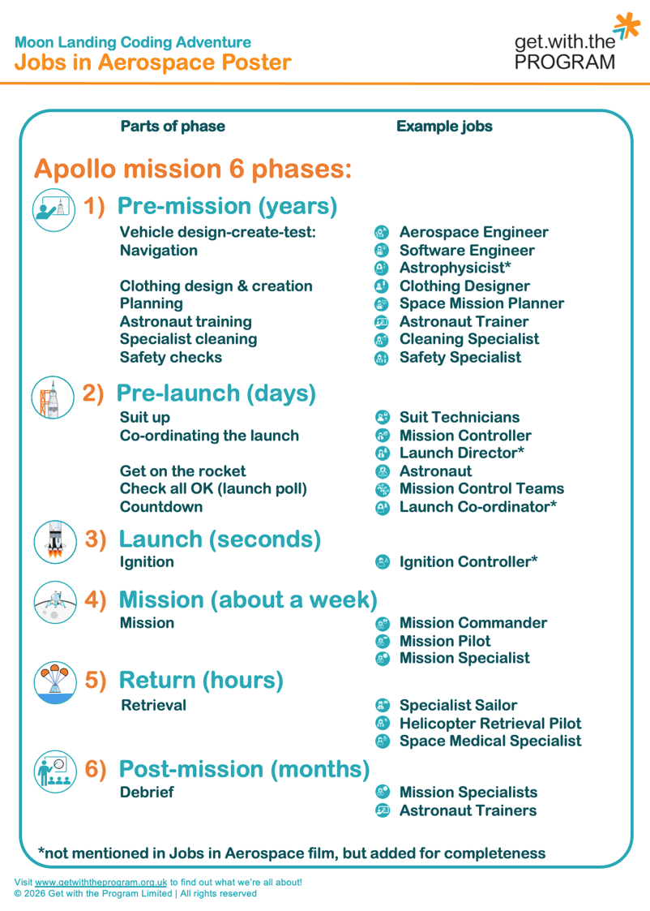









Jobs in Aerospace: Mission phase reminders
Jobs in Aerospace poster …
Apollo mission 6 phases:
Pre-mission (years)
Pre-launch (days)
Launch (seconds)
Mission (about a week)
Return (hours)
Post-mission (months)

Slide 4











Jobs in Aerospace and the skills involved
An Aerospace Engineer designs, builds and tests machines that fly as well as their launch components.
A Cleaning Specialist
helps keep spacecraft, satellites, equipment and work areas clean.
They help make sure these machines and components are safe, fully tested, and work properly.
Aerospace engineers solve problems, work as part of a team and come up with new ideas.
Their work helps ensure anything being sent into space has no unwanted items like dirt, to reduce the chance of things going wrong.
Cleaning specialists are especially important during the ‘create’ and ‘assembly’ (putting together) part of any space mission.
Skills involved in this role:
Skills involved in this role:
Creativity
skills
Problem solving skills
Maths
skills
Science
skills
Adaptability
skills
Planning
skills
Teamwork
skills
Cleaning
skills
Planning
skills
Adaptability
skills
Problem solving skills

Slide 5




Jobs in Aerospace and the skills involved
A Clothing Designer
helps create the special clothes including spacesuits that astronauts wear in space.
A Software Engineer
or Computer Scientist
writes computer programs that help rockets, spacecraft and astronauts.
They make sure all the clothes and spacesuits are made for their specific use.
For instance, they make sure the spacesuits protect astronauts from the extreme temperatures of space.
Spacesuits are like tiny spacecraft that astronauts can wear!
They write and test code that can control spacecraft, collect information, communicate with Earth and solve problems during missions.
They make sure the technology works properly so that space missions can be completed safely and successfully.
Skills involved in this role:
Skills involved in this role:
Creativity
skills
Sewing
skills
Maths
skills
Problem solving skills
Planning
skills
Teamwork
skills
Maths
skills
Planning
skills
Adaptability
skills
Problem solving skills

Slide 6



Jobs in Aerospace and the skills involved
An Astronaut Trainer
helps astronauts learn all the skills they need before they travel into space.
A Mission Controller
helps astronauts from Earth while they are on a space mission.
They teach astronauts how to use spacecraft, work as a team, stay safe,
and solve problems.
Astronaut trainers create practice activities that help astronauts prepare for things such as floating in zero gravity, carrying out experiments, or dealing with emergencies.
They work in a control centre filled with computers and screens that show information about the spacecraft.
Mission controllers watch how the spacecraft is working, solve problems, and give astronauts important instructions.
They help make sure the mission stays safe.
Skills involved in this role:
Skills involved in this role:
Speaking
skills
Problem solving skills
Teamwork
skills
Science
skills
Planning
skills
Teamwork
skills
Problem solving skills
Planning
skills
Adaptability
skills
Speaking
skills

Slide 7





Jobs in Aerospace and the skills involved
A Space Medical Specialist
helps astronauts stay healthy before, during and after their space missions.
A Safety Specialist
makes sure that space missions are as safe as possible.
They check astronauts' health, help them exercise, and make sure they know what to do if they feel unwell in space.
They also study how living in space affects the human body.
They check equipment, look for problems that might cause accidents, and help create safety rules for astronauts and engineers to follow.
Safety specialists help to assess the risks of going into space.
Skills involved in this role:
Skills involved in this role:
Health
skills
Problem solving skills
Science
skills
Listening
skills
Food
skills
Problem solving skills
Planning
skills
Teamwork
skills
Adaptability
skills
Cleaning
skills

Slide 8



Jobs in Aerospace and the skills involved
An Astronaut travels into space
to explore and carry out experiments.
A Spacesuit Technician
builds and checks spacesuits and helps astronauts get into them before launch
They help scientists learn more about our universe.
Astronauts work as part of a team, operate spacecraft, solve problems, and often spend months training for their missions.
They often have specialist roles, such as commander, pilot or mission specialist.
Spacesuit technicians make sure astronauts are safe in space.
They check the suit to ensure it can provide air and protect them from the harsh conditions of space.
They help them get into their suits just before launch.
Skills involved in this role:
Skills involved in this role:
Teamwork
skills
Problem solving skills
Adaptability
skills
Exercise
skills
Speaking
skills
Planning
skills
Sewing
skills
Science
skills
Maths
skills
Problem solving skills

Slide 9
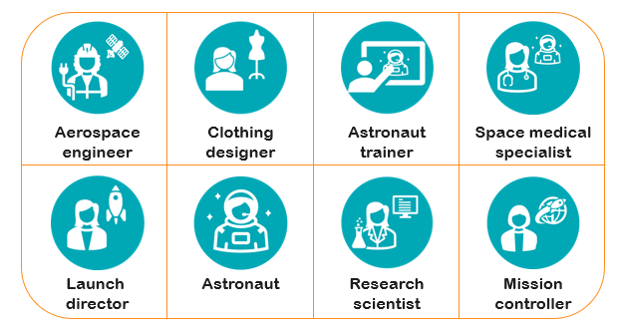

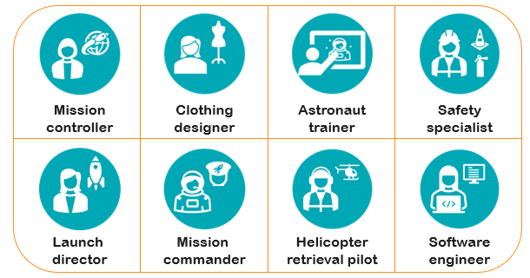
Follow-on activities…
‘Jobs in Aerospace’ Bingo
This is a bingo game, but with names for aerospace jobs instead of numbers.
It can be played in pairs, small groups or independently.
Listen or watch out for the jobs on your board and either mark them off, or put a counter on a job when you see or hear it. Remember if you are given one board each, some of you may have the same ones, so you must pay attention and call out ‘bingo’ first to win!
A winner can be determined by filling a row of 4, or whole board.
You may have to listen for the jobs to be called out, or you may be given a pile of jobs to pick from.
Have fun!

Slide 10
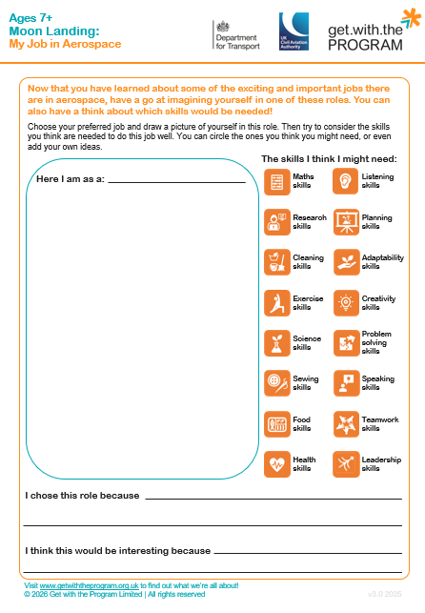
Follow-on activities…
‘My Job in Aerospace’ Worksheet
This is a task for you to really think about what job in aerospace you would most like to do.
Think about what the job might involve.
What skills might you need to do the job?
Why do you think you would like it?
Draw a picture of yourself doing this job and answer the questions to reflect on what the job might be like.
Have fun!

Slide 11
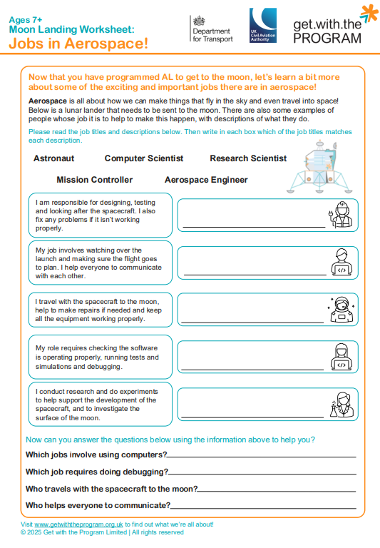
Follow-on activities…
‘Jobs in Aerospace’ Worksheet
This activity is to match up the job descriptions with the names of the jobs.
You need to read through each description carefully and then write the name of which job you think it is.
When you have finished identifying which job is which, you can then answer the questions about the different jobs in aerospace.
Have fun!

Slide 12
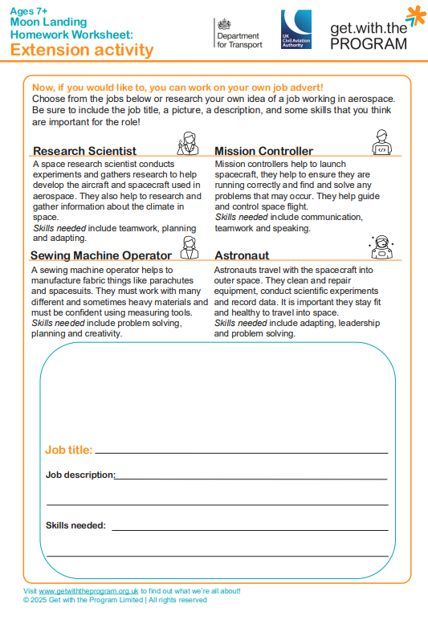
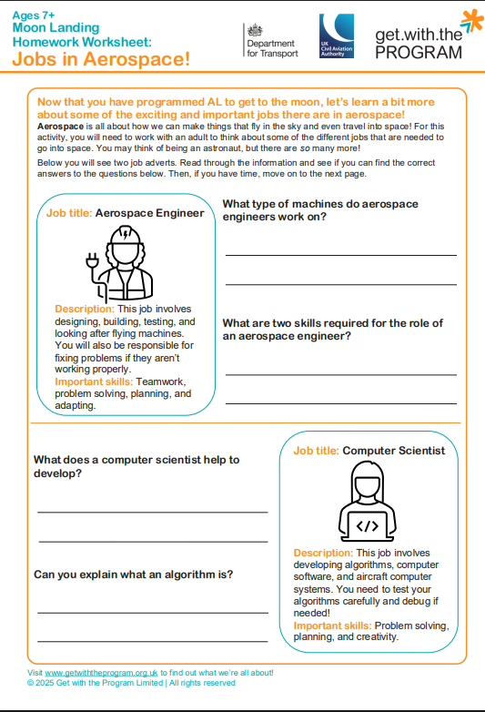
Follow-on activities…
‘Jobs in Aerospace’ Homework sheet
This is a homework activity designed to be done alongside a parent or carer, to also give them insight into jobs in aerospace.
Read through the job adverts for each role and answer the questions about them.
Then, if you have time, move on to the extension task on the second page – create your own job advert. You can use one of the examples given or think of another job in aerospace to choose from – now you know there are so many!
Have fun!

Slide 13
Plenary
Now let’s review what we have just been learning!
Do you remember these jobs?
aerospace engineer safety specialist mission controller
clothing designer cleaning specialist astronaut
Now think about:
  Were there more jobs than you expected?
  What job did you like the sound of the most?
  Would you want to do any of these jobs?
  Why would, or wouldn’t, you want to do them?
?
?
?

Slide 14
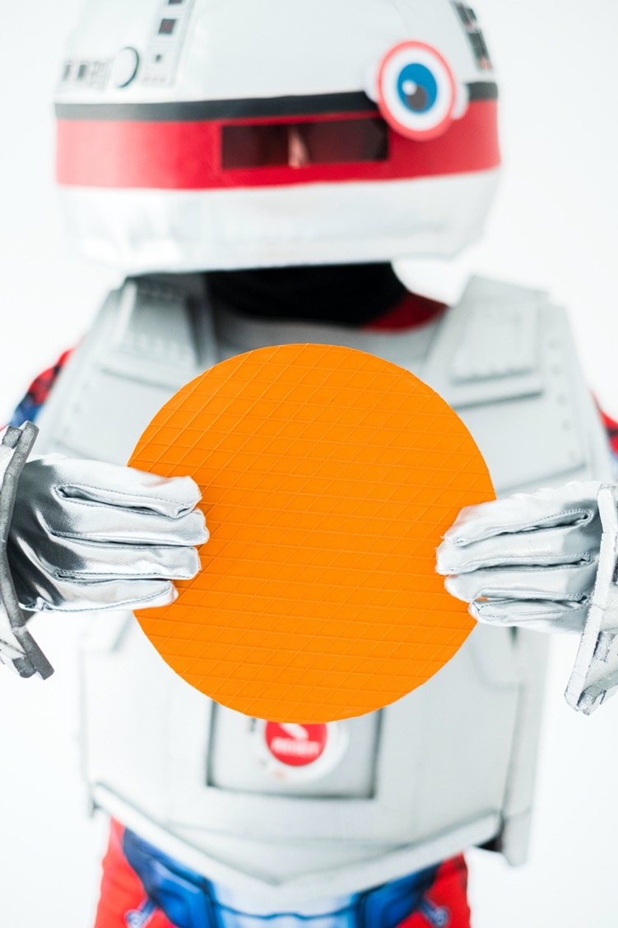





If you’d like more information on how we inspire the tech innovators of the future, get in touch and Get with the Program!
www.getwiththeprogram.org.uk
getintouch@getwiththeprogram.org.uk

