Slide 1


Moon Landing
Coding Activity:
‘Program Each Other’ (PEO)
Teaching guide | ages 7+

Slide 2
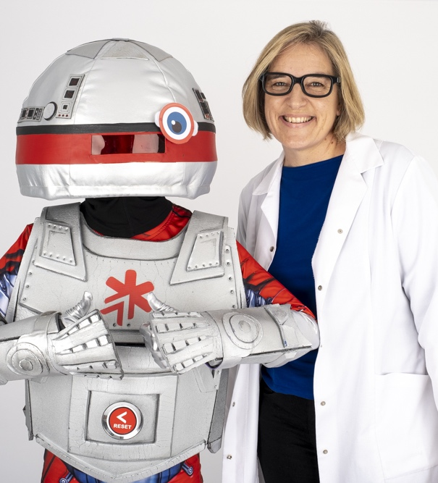
Introduction
Hello from Get with the Program!
We hope you enjoyed our Get with the Program Moon Landing Coding Adventure!
This follow-on activity is designed to be run after seeing the show, to embed the learning and
hopefully have some fun along the way!
This guide contains a list of the resources needed,
how to get started, and step-by-step instructions
for a series of challenges.
There are three challenges. If you get on well with these or have older children, there are also some extension challenges you can have a go at.
Timing: 30-40 minutes. It can be run indoors
or outdoors!

Slide 3
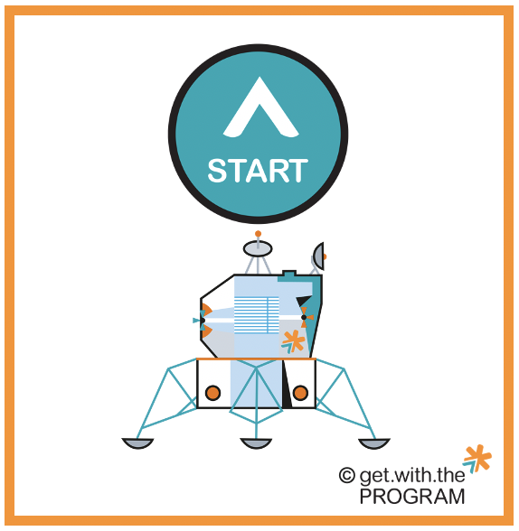



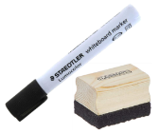






Resources you’ll need
One set per group of three:
Printable resources* for the first challenge:
Whiteboard, whiteboard pen and eraser, or paper and pencils, per child:
Start point
Finish point
Robot
Printable resources* for the later challenges, including items that need to be avoided:
Materials to create a 3 x 4 grid on the floor, such as:
  A4 sheets of paper
  books or cushions (that it's okay to tread on!)
  chalk (if outdoors)
  masking tape
  sports cones
  rubber dots
Do a dance!
*Printable resources are provided in a separate document, make sure you have printed and prepared these beforehand, or found alternatives.

Slide 4

Getting started
Show the Moon Landing Program Each Other (PEO) activity video / slides
You will have been provided with a link to
a short activity video which you can view
in advance to explain things in detail.
When you are ready, watch this with your class/use this Teaching Guide so everyone has an idea of how the activity works.
The class activity needs
one whiteboard per child.
Get ready to begin the Program Each Other (PEO) activity
Get your class into groups of three
Set up your 3 x 4 grids on the floor/table
Get your printable resources/alternatives and whiteboard/paper ready
You’re ready to begin!
The following slides are designed to be used as a guide for you in class

Slide 5
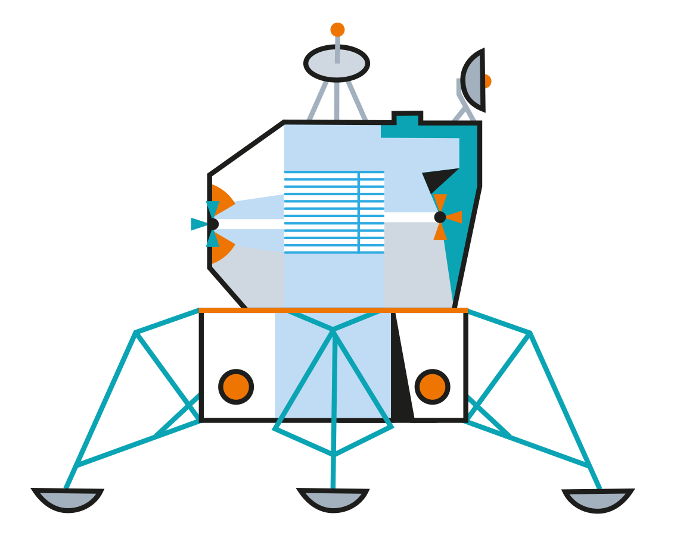

About this activity
Can you help AL the Robot?
Now that AL has successfully followed her algorithm to get to the moon, she has been asked to collect moon rocks to be taken back to Earth to see what they are made of.
The grid represents an area of the moon. Can you ‘program each other’ to collect the moon rocks, but avoid falling into any craters?
Learning intention:
Design, write and test an algorithm to program a robot to collect moon rocks to bring back to Earth!
Learning intention
Key words
algorithm
design
test
debug
repetition*
selection*
input*
I can...
Design and record an algorithm to achieve a goal
Debug an algorithm
Choose an option using selection*
Say how repetition makes the algorithm more efficient*
Work well in a group
* extension challenges

Slide 6









Essential Skills
Skills Builder
The Skills Builder Partnership works to ensure that one day everyone builds the essential skills to thrive. The 8 essential skills can be found below, with the appropriate Skills Builder steps you will be working towards while completing this activity.
Step 2:
I listen to others and can ask questions if I don’t understand
Step 3:
I speak effectively by making points in a logical order
Step 2:
I complete tasks by explaining problems to someone for advice if I need
Step 4:
I generate ideas to improve something
Step 3:
I keep trying and stay calm when something goes wrong
Step 3:
I work with pride when I am being successful
Step 2:
I know how to recognise others’ feelings about something
Step 3:
I work well with others by taking responsibility for completing my tasks
Notes:
The Skills Builder Partnership works to ensure that one day everyone builds the essential skills to thrive. They bring together more than 800 organisations towards that collective mission, including educators, employers and other impact organisations. Skills Builder provide a framework for the 8 Essential skills
https://www.skillsbuilder.org/
Essential skills unlock learning in the classroom, boosting academic outcomes, perseverance and self-belief. The product of five years’ cutting-edge research and design, the Skills Builder Universal Framework makes it possible for everyone to teach, learn, and measure essential skills.
The Framework takes each of the eight essential skills, and breaks them down into 16 sequential steps which span from being an absolute beginner in the skills, to achieving a high level of mastery. It acts as a reflection tool for reviewing an individual’s current skillset and as a roadmap for further development.

Slide 7




First choose roles
Designer places the items on the grid and plans the route the robot will take to get to them
Designer
Writer records the steps with a whiteboard and pen / piece of paper and pencil
Writer
Tester takes the whiteboard and follows the instructions that are written down
Tester
How about swapping roles as you go, so that everyone has a turn?

Slide 8

Challenge 1 – Get to the item
Can you move across the moon to collect the moon rock?
Designer: Place the lunar lander for ‘start’ and the moon rock for ‘finish’ anywhere on the grid. Use the robot to design the route the tester needs to follow to get across the moon to the moon rock.
Writer: Record the route (algorithm) the tester needs to take on the whiteboard using forward, left and right arrows.
Tester: Follow the instructions on the whiteboard to test the algorithm. You must follow the instructions exactly, even if you know they aren’t right – you might go off the grid! If this happens, don't worry. Work with the designer and writer to debug the algorithm and try again!
Example grid layout:
Essential Skills being developed:

Slide 9



Challenge 2 – avoid items
There is another moon rock to collect but some craters we want to avoid. Can you program the robot to miss these items?
Designer: Choose where to add in the extra craters. Design the algorithm as before, making sure to go around the ‘avoid’ items to get to the 'finish' item.
Writer: Record the algorithm on the whiteboard using forward, left and right arrows. It will probably be a bit more complicated than last time!
Tester: Use the whiteboard to follow the algorithm to test it. Did you get it right? Debug if needed and try again.
Example grid layout:
Essential Skills being developed:

Slide 10

Challenge 3 – creative coding
Now, can you use your imaginations to think of some other things to include in your algorithm?
Maybe you can add in lots of extra moon rocks, and design a route for the robot to collect them all?
Could you create a specific instruction to pick up items? What would this look like in the algorithm?
Maybe the robot can jump over ‘avoid' items?
Maybe they should do a happy dance when they’ve successfully collected the moon rocks?
What other creative coding can you think of?
Designer: Plan what steps to add in, and where they should go in the algorithm. You can use one of your blank squares to draw on or cut up some paper.
Writer: Record the algorithm on the whiteboard – make up new pictures for the new actions.
Tester: Use the whiteboard to follow the algorithm to test it. Debug if needed and try again.
Example grid layout:
Do a dance!
Essential Skills being developed:

Slide 11



Extension challenges
These extension challenges build towards Scratch programming and use more complex key terms to do it! Here is some information about the terms
Repetition
Repetition is looping or repeating sections of an algorithm so the steps can be reused
Selection
Selection is making a choice to take a path in the algorithm, based on other information you have
Input
Input is when you have some information that comes into the algorithm

Slide 12
Extension challenge 1 – repetition
For this challenge, we are going to put all the moon rocks in one place, and program the robot to collect them one-by-one and bring them back to the start.
Designer: Can you program the robot to do this? The robot can only carry one item at a time so will need to return to the start to repeat the instructions again.
A loop that is repeated like this is called repetition.
Writer: Record the algorithm on the whiteboard using forward, left and right arrows, and including a repeat instruction - think about what this might look like.
Tester: Use the whiteboard to follow the algorithm to test it. Did you get there and back without any problems? Don't worry if it didn’t go as planned – debug and try again!
Example grid layout:
(also see extension demo video / slides)
Essential Skills being developed:
Hint: What position does the robot need to be in at the end before it can repeat the algorithm?

Slide 13
Extension challenge 2 - selection
For this challenge, can you help the robot make the right choice when deciding between two options of moon rocks?
Designer: Shuffle the cards and lay them face down on one spot somewhere on the grid. As before, you will need to plan the route the robot should take to get to the items. The robot will pick up the items one-by-one – if a moon rock is whole, the robot needs to take it back to the 'start’ lunar lander. If it is a broken one, the robot needs to take it to the crater to throw it away.
Writer: Record the algorithm as planned out by the designer on the whiteboard using forward, left and right arrows. When you get to the cards, you will need to include pick-up and selection instructions. Choose how you will write this selection (e.g. a choice of path or 'IF' step) in your instructions.
Tester: Use the whiteboard to follow the algorithm to test it. Don't forget to test both paths! Don't worry if anything doesn’t go as planned – debug and try again!
Example grid layout:
(also see extension demo video / slides)
Essential Skills being developed:

Slide 14
Extension super challenge – with added input
This challenge builds on the previous two extension challenges (repetition and selection) with added input:
For this challenge, the designer or writer is going to be in charge of input – decide who it will be before you start. When the algorithm begins, you will need to stand next to the start and hand the tester
the cards one-by-one, this is the input. When the tester is handed
a card, they must decide whether it is a whole moon rock, and take it to the new moon rock bag, or if it is a broken one, in which case it goes into the crater.
Designer: Place the robot on the 'start’ lunar lander and put the moon rock bag and crater nearby. Hand all the moon rock item cards face down to the person controlling the input. Plan the route the robot takes to both the moon rock bag and crater.
Writer: Record the algorithm on the whiteboard. You will need to use an 'IF' step at the beginning, for selection, then use forward, left and right arrows to get to the bag or crater, and include a repetition or loop step at the end. What might these look like?
Tester: Turn over the card when you are handed it and use the 'IF' step on the whiteboard to decide whether to take it to the bag or crater. Follow the algorithm to test it. Debug if needed.
Example grid layout:
(also see extension demo video / slides)
Essential Skills being developed:

Slide 15
Plenary
Now let’s review what happened!
Do you know what these words mean?
algorithm design test debug
repetition* selection* input*
As a group:
  What went well during this activity?
  What did you find challenging?
  What creative instructions did you design?
  What items would you put in a healthy lunch bag?
?
?
?
*extension challenges

Slide 16
Plenary definition answers
Here are our definitions of the key words:
  algorithm a step-by-step set of instructions
  design when you think things through before you start
  test when you check if something works as expected
  debug trying different things until you get what you hoped for
  repetition* looping or repeating sections of an algorithm so the steps can
  be reused
  selection* making a choice to take a path in the algorithm based on other information you might have
  input* when you have some information that comes into the algorithm
*extension challenges

Slide 17





If you’d like more information on how we inspire the tech innovators of the future, get in touch and Get with the Program!
www.getwiththeprogram.org.uk
getintouch@getwiththeprogram.org.uk

